Slide 1
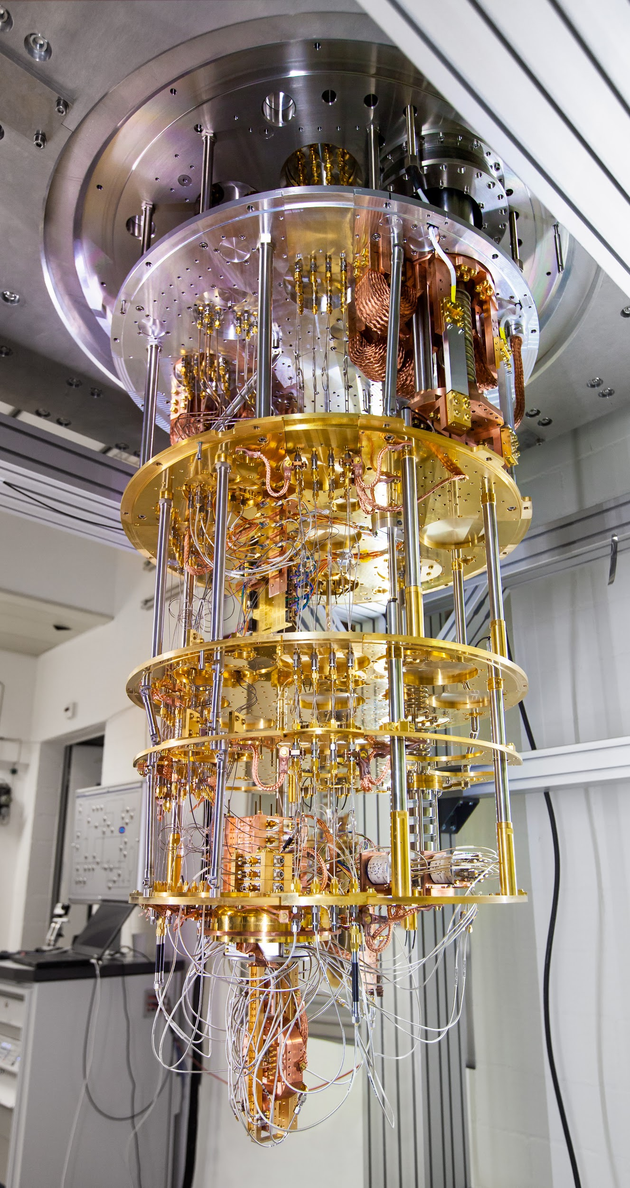

Security Comparisons and Performance Analyses of Post-Quantum Signature Algorithms
Authors:
Manohar Raavi¹,
Simeon Wuthier¹,
Pranav Chandramouli¹, Yaroslav Balytskyi²,
Xiaobo Zhou¹, and
Sang-Yoon Chang¹
1. Department of Computer Science,
2. Department of Physics and Energy Science
This material is based upon work supported by the National Science Foundation (NSF) under Grant No. 1922410. This research is also supported in part by Colorado State Bill 18-086.
Accepted in International Conference on Applied Cryptography and Network Security (ACNS) 2021
Image source: IBM https://fineartamerica.com/featured/1-ibm-q-quantum-computer-cryostat-ibm-researchscience-photo-library.html
Notes:
Hello, I’ll be presenting on the security comparisons and performance analyses of post-quantum signature algorithms. This project is cross-department, with the department of computer science, and the department of physics and energy science, and is supported by the National Science Foundation and Colorado State Bill 18-086. Our group consists of Manohar, Simeon, Pranav, Yaroslav, Dr. Zhou, and Dr. Chang. And this paper was accepted for publication in the ACNS 2021 conference.

Slide 2

Digital Signature Algorithms
Digital signature algorithms must have:
Integrity
Authenticity
Non-repudiation
Alice
Alice
Private key
Two parts
Key generation
Key use
Message signing
Message verification
Hello World
Private key
Public key
Private key
Hello World
Hello World
Bob
Bob
Public key
Notes:
So what is a digital signature algorithm? Let’s say you’d like to login to banking website, then you’ll see the little lock icon next to the URL, this is basically saying that a signature is being used to ensure the authenticity of the data being transmitted. A digital signature algorithm must have integrity, authenticity, and non-repudiation. Let’s say that Alice would like to send a “Hello World” message to Bob, then a digital signature algorithm can be used to generate a public-private key pair, use the private key to sign the hello world message and generate a signature. Then the signature and hello world message will be sent over the internet to Bob. When Bob receives the message, he will use the public key to verify that the message is authentic using the signature, because since it’s sent over the internet, the message can be tampered with, but this gives us a way to ensure that the message is cryptographically secure. The private key is only known by Alice, because it grants the power to sign the message, the public key can be known by anyone since it can only be used to verify validity

Slide 3

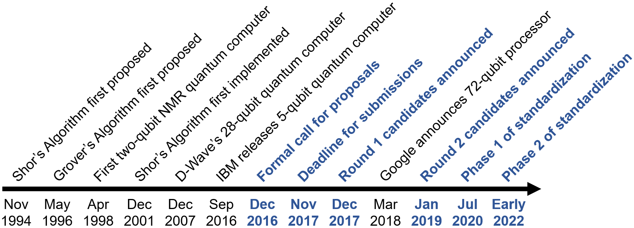
Post-Quantum Cryptography
Most used signature algorithms today:
RSA
ECDSA
Finalist post-quantum signature algorithms:
Dilithium
Falcon
Rainbow
Insecure against a quantum computers using Shor’s algorithm!
One will become standardized
But which?
Notes:
The current signature standards are RSA and ECDSA, however these are insecure against a quantum computer using Shor’s algorithm. So back in 2016 NIST released a call for proposals asking people to submit quantum-resistant algorithms. And throughout the years the submissions have been filtered down, just recently in July of this year the phase 1 of standardization began, and only three finalist algorithms were left standing: Dilithium, Falcon, and Rainbow.
So if you look in that timeline, early 2022 will be the phase 2 of standardization , where only one algorithm will remain, and this one will be standardized.
The three finalists: Dilithium, Falcon, and Rainbow are families of algorithms, so they each provide different levels of security that optimize different parameters.

Slide 4
Our Problem Statement
Dilithium and Falcon are Lattice-based
(based on short integer/vector problems to generate random keys).
Rainbow is Multivariate-based
(based on quadratic polynomials to generate random keys).
Issues:
Different design backgrounds make it difficult to compare the schemes.
Dilithium and Falcon’s security is in qubits
Rainbow’s security is in quantum gates
Performance / scalability issues when message sizes vary.
Our Approach:
Security Comparison: Visualize size-security trade-offs and the DW costs
Performance Analyses: Measure the time durations of each part of the algorithms
Cannot be compared!
Notes:
Our problem statement is that as of right now there is no easy way to compare between these algorithms, to see which are optimal. If you want to secure an application from quantum computing, there’s not a whole lot of insight about how to do it, which algorithms are more secure, which run faster, and so on. Since Dilithium and Falcon speak in qubits, and Rainbow speaks in quantum gates, this makes the task much more difficult. So our work fills these gaps by making security, performance, and size comparison visualizations.

Slide 5
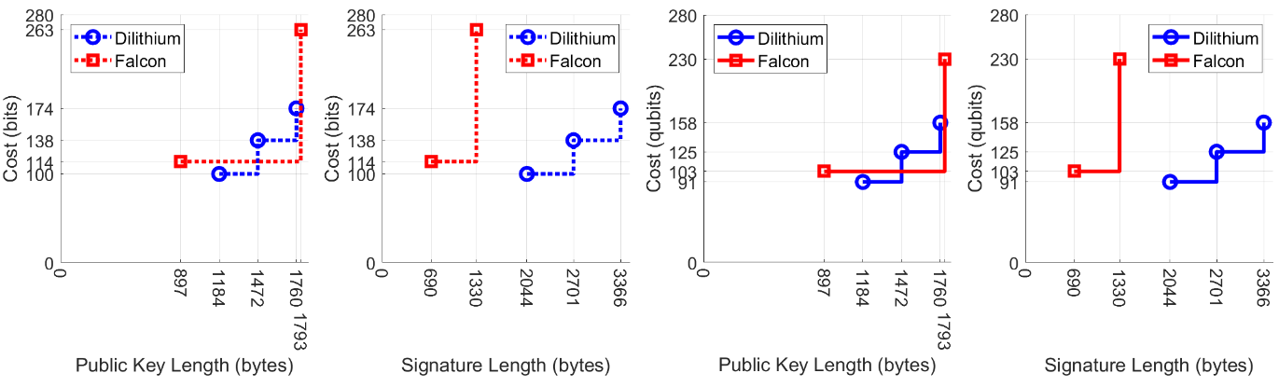
Our Contributions: Size-security trade-offs
X-axis: Number of bytes required to generate
Y-axis: Classical bit cost vs. Quantum bit (qubit) cost
(more bits = more security)
Notes:
For our contributions, firstly we compare the size overheads with the security of each algorithm.
The x axis is the size consisting of the public key and signature, in bytes. The y-axis quantifies the security of how difficult it is to break such an algorithm, where qubits are ran on a quantum computer and bits are ran on a classical computer. These plots compare Dilithium and Falcon…

Slide 6
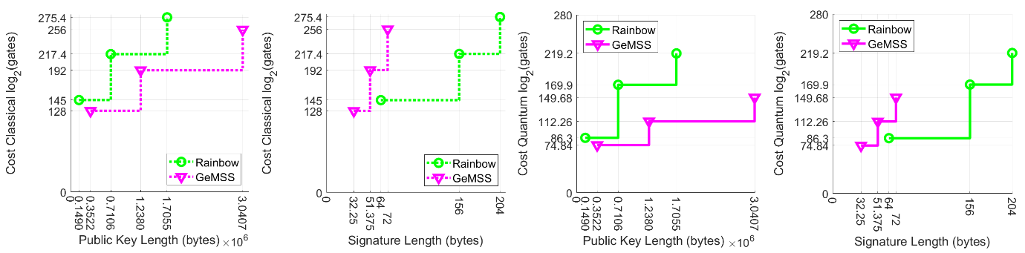
Our Contributions: Size-security trade-offs
X-axis: Number of bytes required to generate
Y-axis: Classical gate cost vs. Quantum gate cost
(more gates = more security)
Notes:
And these plots compare Rainbow and GeMSS, using classical gates and quantum gates. So from these, we can see that Rainbow outperforms GeMSS in public keys, because the size overhead is smaller while the security in gates and quantum gates are both greater. The goal in these plots is to minimize the x value, or bytes, and maximize the y value, which is the security.

Slide 7
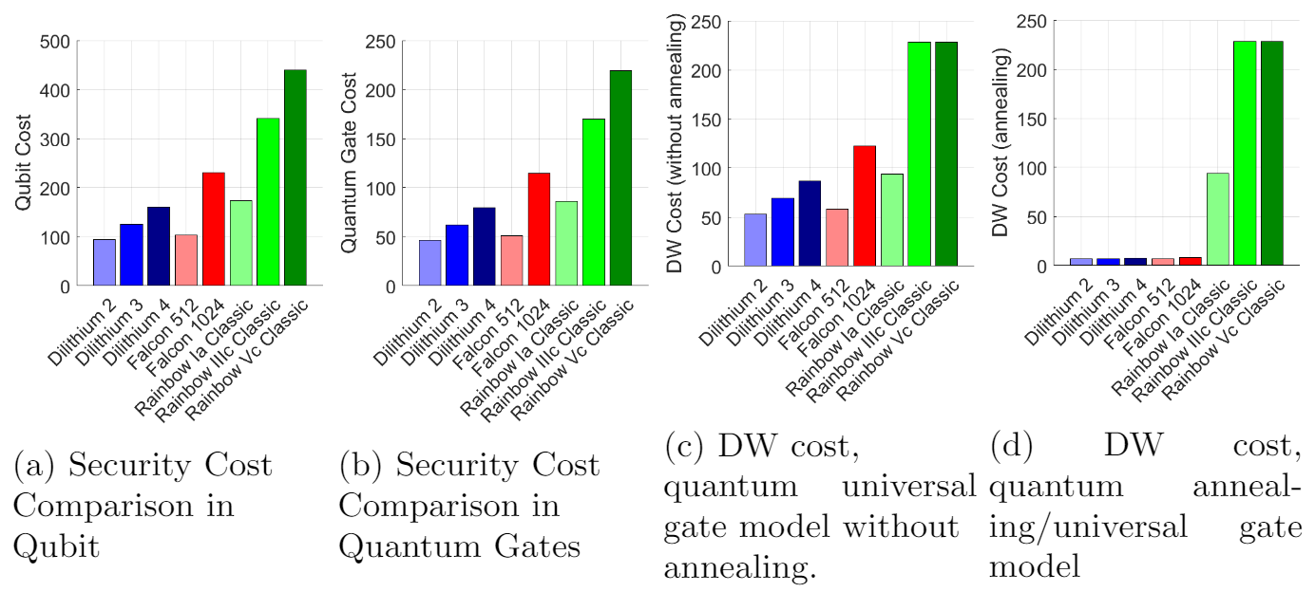
Our Contributions: DW costs
Used in:
Universal Quantum Gate Model
Quantum Annealing Model
Notes:
We perform a depth-width comparison across all algorithms as well, using the universal quantum gate model, and quantum annealing model. The DW cost is basically the total number of gate operations required to run each algorithm, and this is done because it combines all three finalist algorithms into a unit that can be compared. As you can see Dilithium 2 has the lowest DW costs, followed by Falcon 512. Rainbow Vc Classic has the highest DW costs.

Slide 8
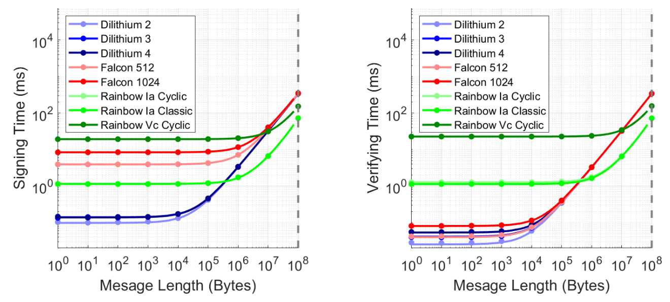
Our Contributions: Performance Analysis
Measured the time it takes each to sign and verify
Use Rainbow if the message length is greater than 387,578 bytes, otherwise use Dilithium.
Notes:
We run a performance analysis on all the algorithms, by varying the message lengths between 1 and 100 million bytes (or 100 megabytes). We take a new sample for every power of 10. As expected we can see the time that it takes each algorithm to run increases as we increase the message size, but they also increase at different rates. So the next step was to link the points together by computing the equations for lines of best fit. Then for the analysis, we found that in order to optimize runtime (i.e. get the minimum of all the lines), it’s actually have a conditional between two of the algorithms. We found that in order to optimize performance, you should use Rainbow if the message length is greater than 387 , 578 bytes, otherwise for smaller messages we recommend using Dilithium

Slide 9


Our Future Research
Implement the signature schemes into
and
Notes:
As for our our future research, currently we are implementing these digital signature schemes into QUIC, and Bitcoin. So QUIC is a transport layer networking protocol created by Google, and Bitcoin is the first, and most popular cryptocurrency, with a market capitalization of 200 billion dollars. Despite the popularity, these two applications depend on signature schemes that are not quantum resistant… and as quantum computing becomes more feasible in every-day use, these applications will become more insecure, and that’s why we’re currently integrating these post-quantum signature algorithms into these applications, to make them future proof.

Slide 10
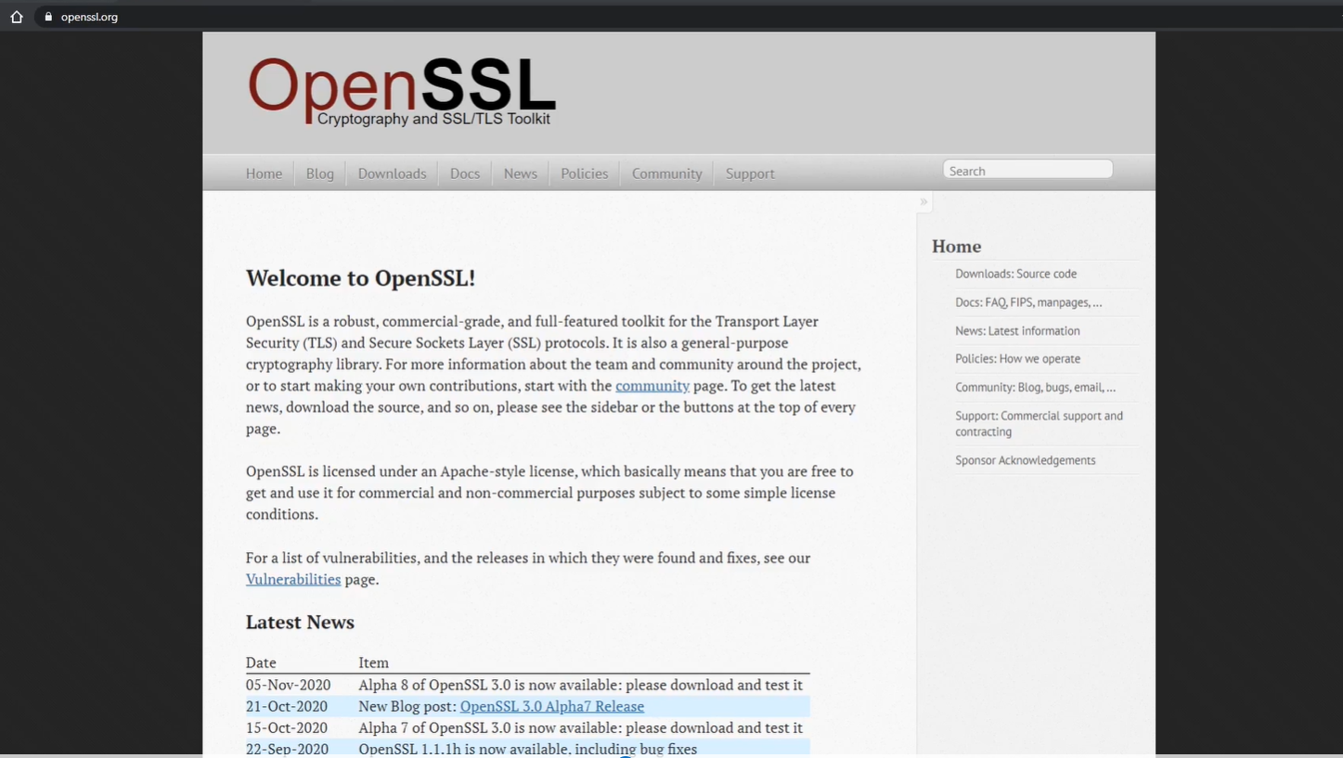
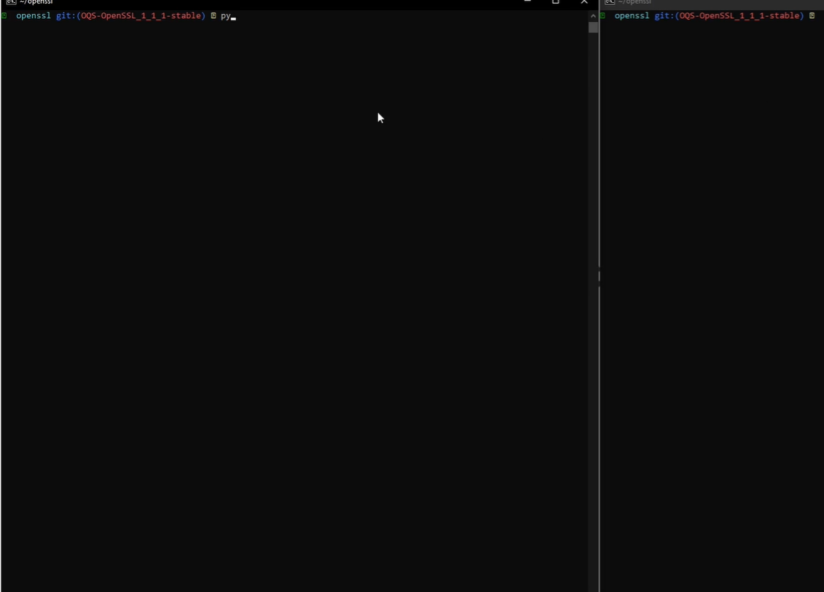
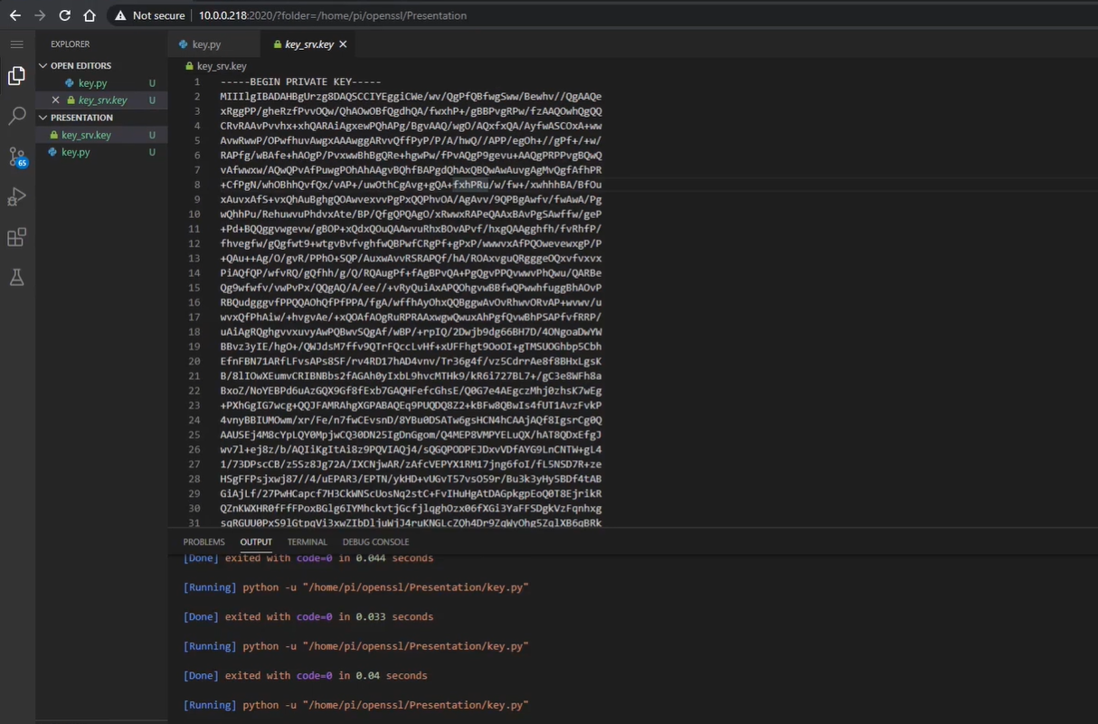
Demo and Contact Information
To learn more, Pranav provided a demo
https://youtu.be/sNw9dLfYxkU
Manohar Raavi - mraavi@uccs.edu
Simeon Wuthier - swuthier@uccs.edu
Sang-Yoon Chang - schang2@uccs.edu
Notes:
We also had Pranav provide a demo of this research in action, which you can view in the link provided
If you’d like to discuss more or if you have any questions, feel free to contact us through emails provided, or in the discussion below, we would love to hear from you.

Slide 11
ACNS 2021 : June 21-24, 2021
Notes:
That concludes our presentation. The ACNS 2021 conference will be held June 21st 2021, so be on the lookout for our publication. Thanks for listening!

